Slide 1
The Future is Electric Project 2 Ev Chargers across America
Team Members:
Haitham Mostafa
Nebeyu Zewdie
Snejana Balabanova
Zaheer Rizvi

Slide 2
Project 2 Proposal
We will present data visualizations of electric vehicle chargers across the United States, we will include details about each charger.
The data source: US Dept. of Energy, https://developer.nrel.gov/docs/transportation/alt-fuel-stations-v1/all/.
The dataset includes many types of alternative fuel chargers, such as natural gas or fuel cells, but we will focus on electric vehicle chargers only.
We will be running our database with SQLite.

Slide 3
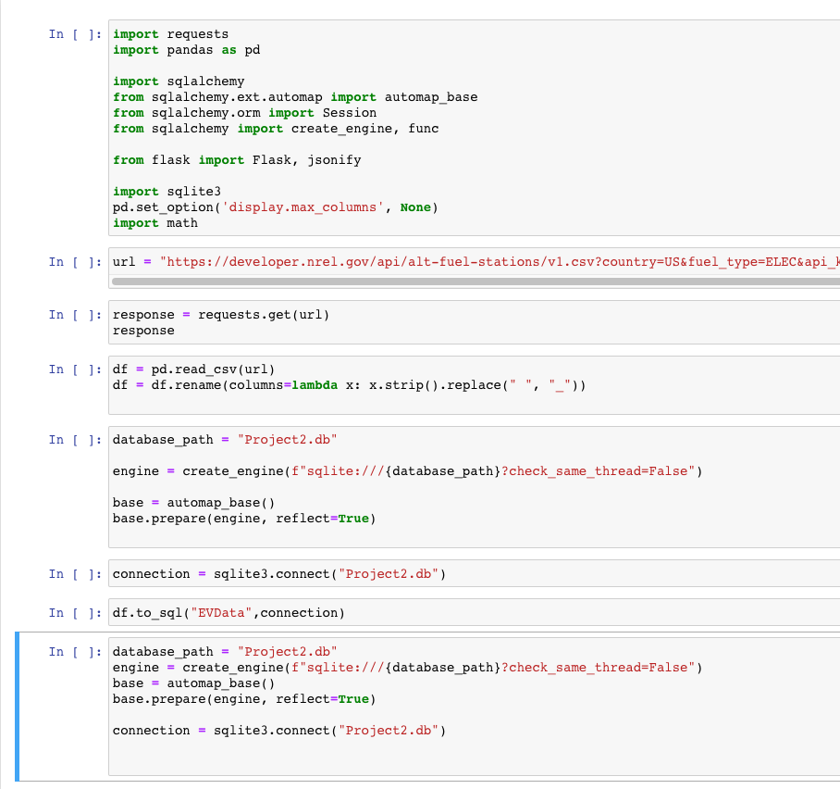
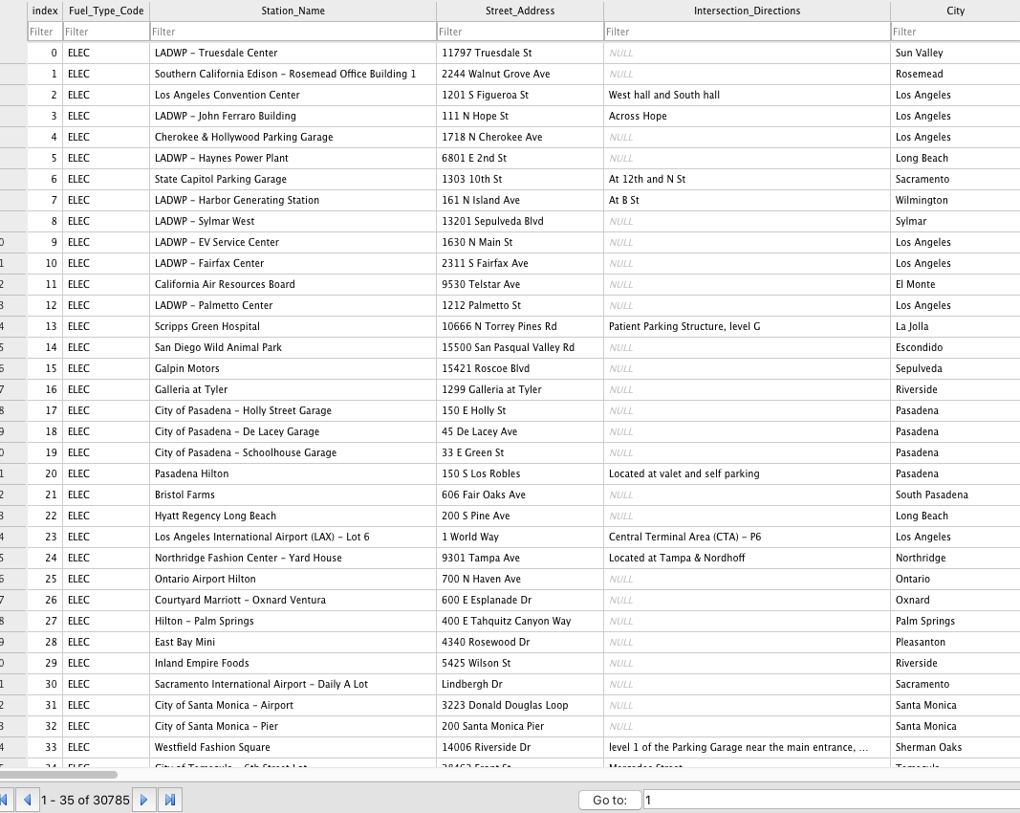
Setting up the database

Slide 4
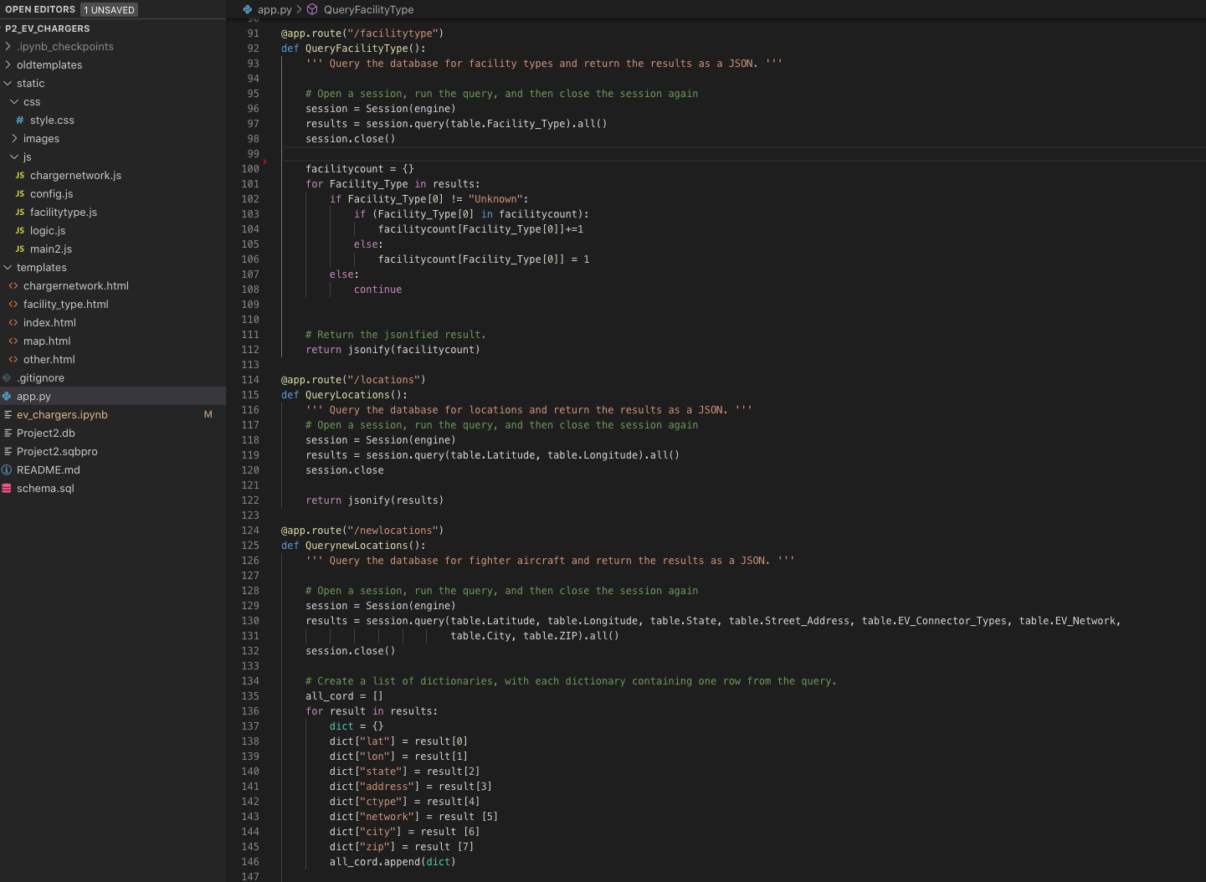
App.py

Slide 5
Visualizations used
Bar chart of how many chargers in each state.
Table that demonstrates the type of connectors and how many there are
Line chart which tells us what type of facility that charger is located in.
A map of the chargers across America.

Slide 6
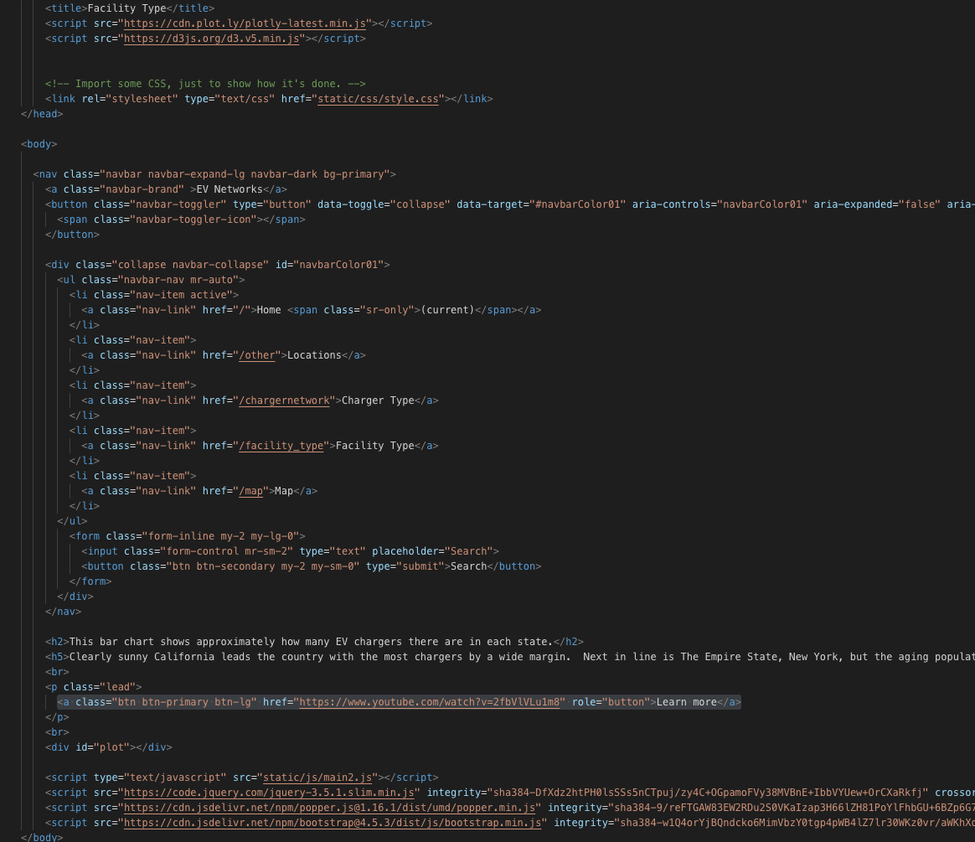
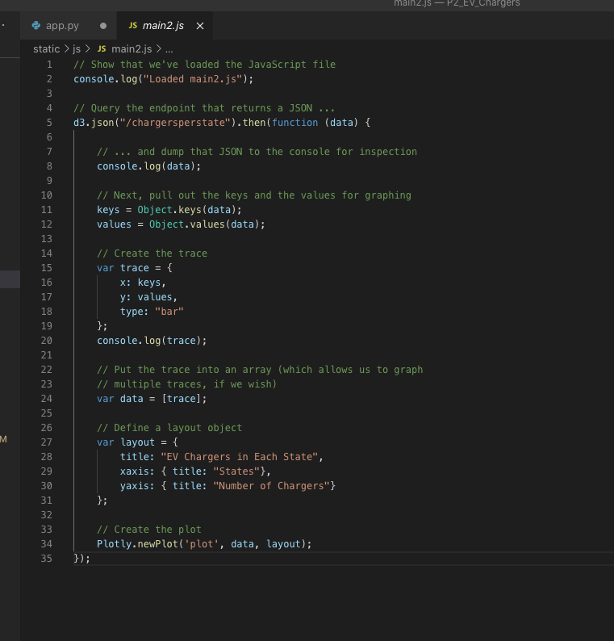
Locations code

Slide 7
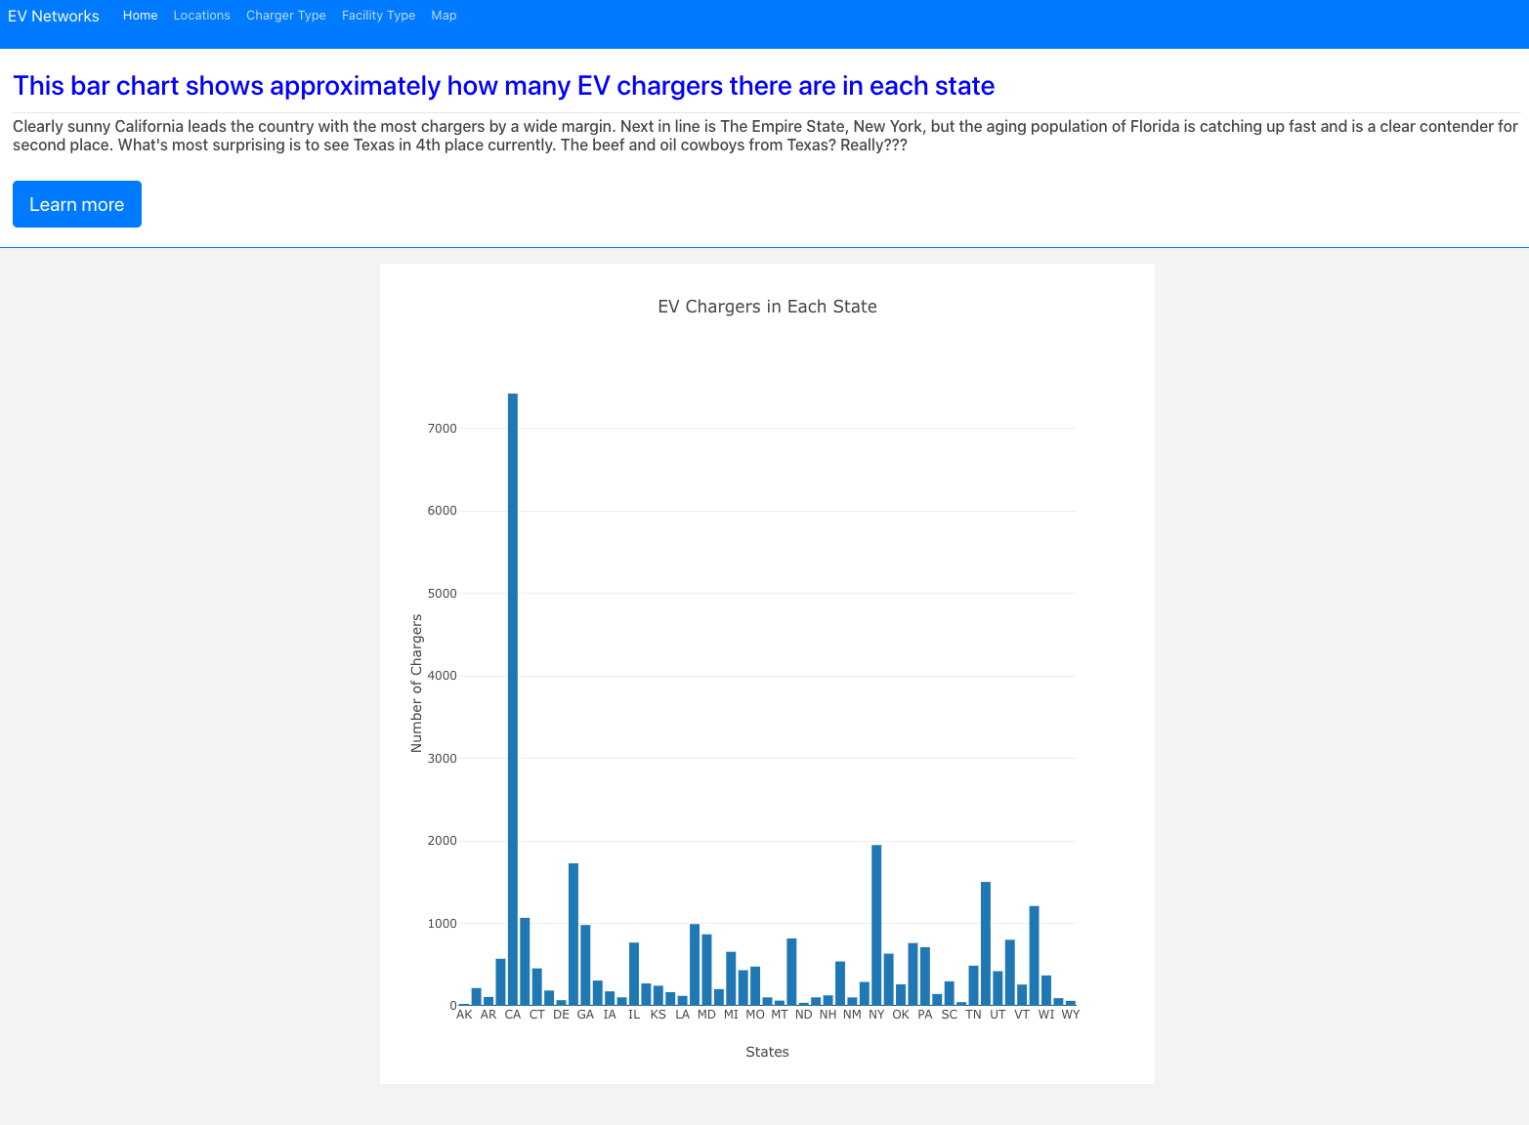
locations

Slide 8
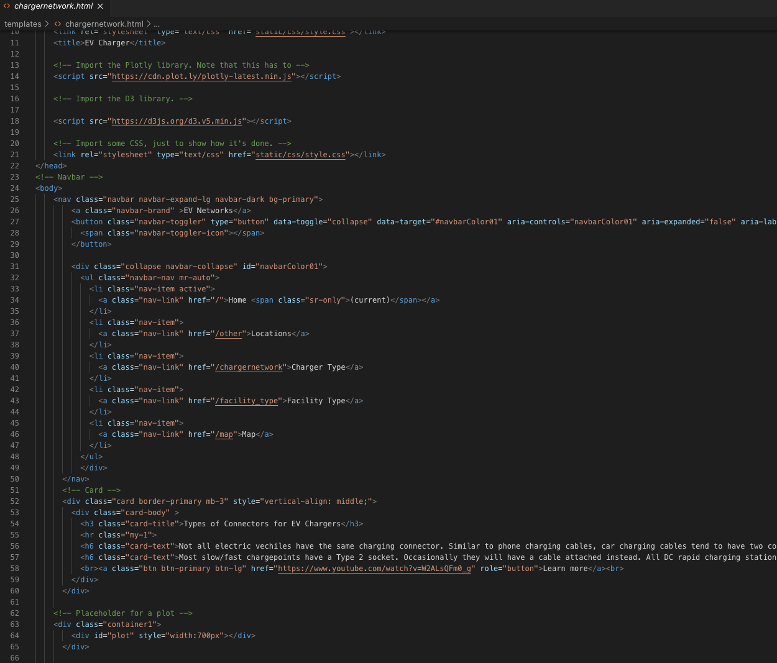
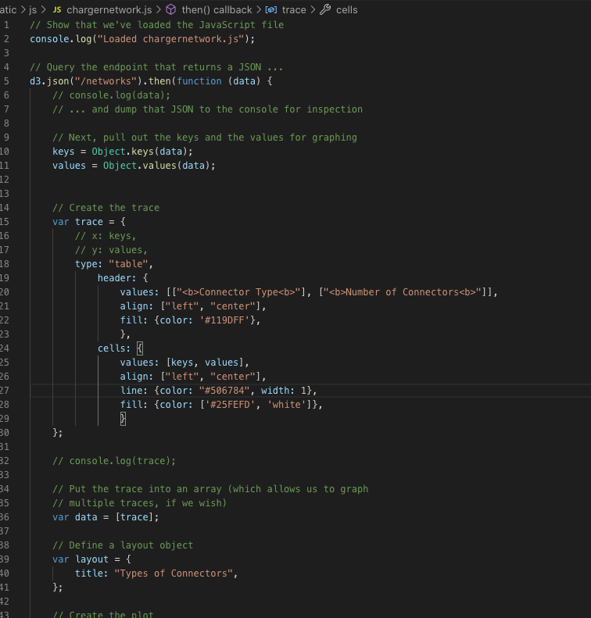
Charger type

Slide 9
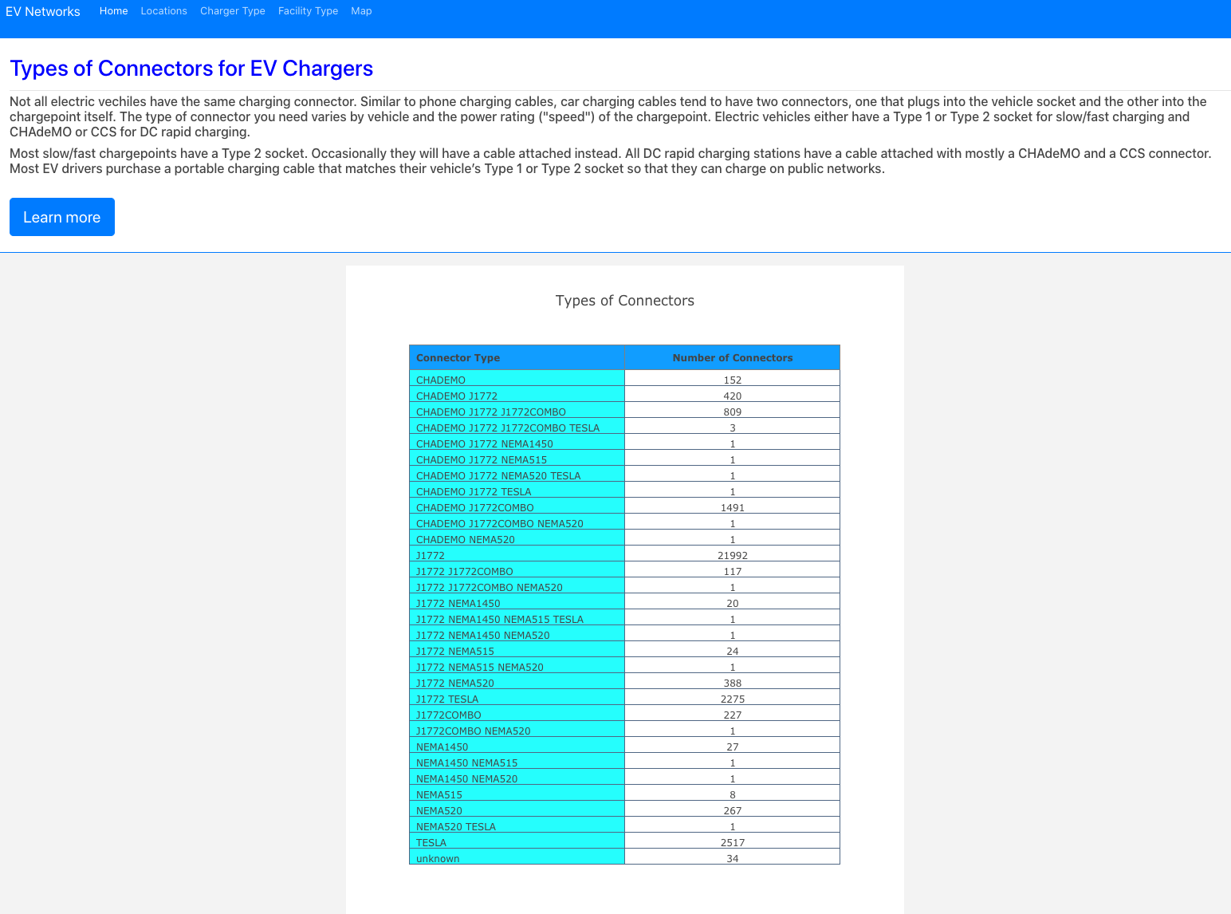
Charger type

Slide 10
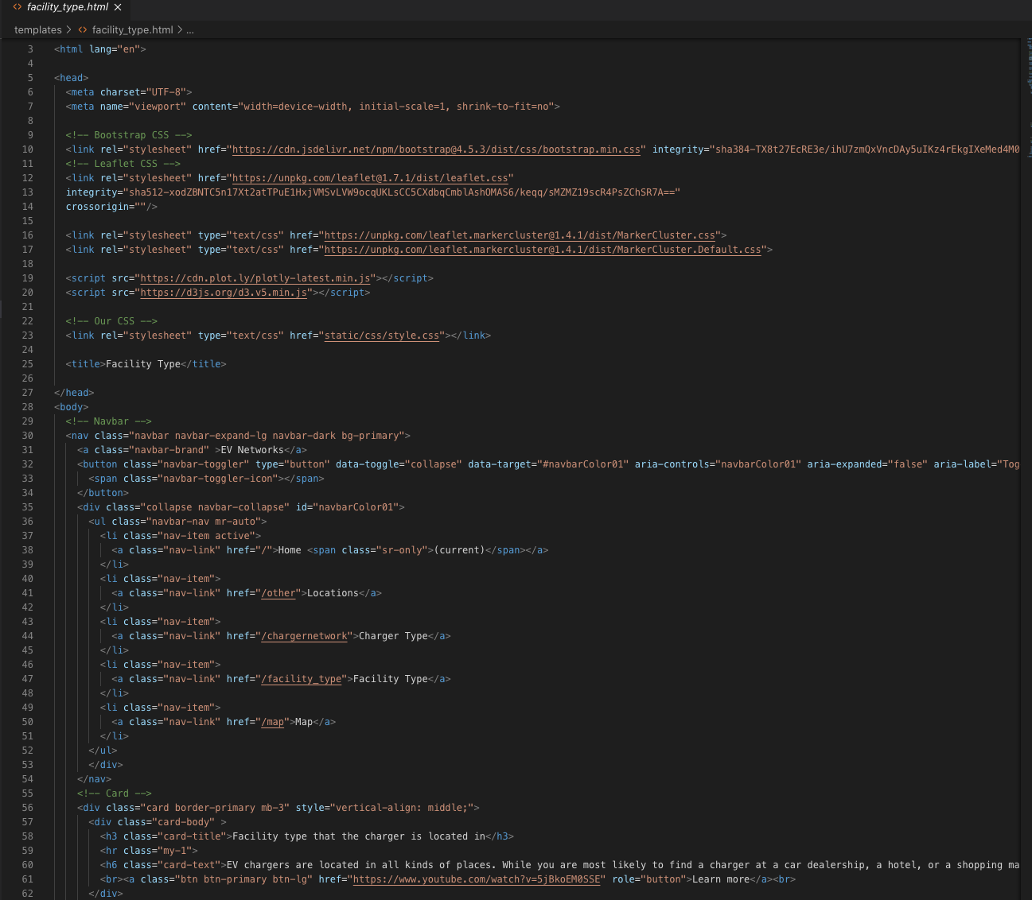
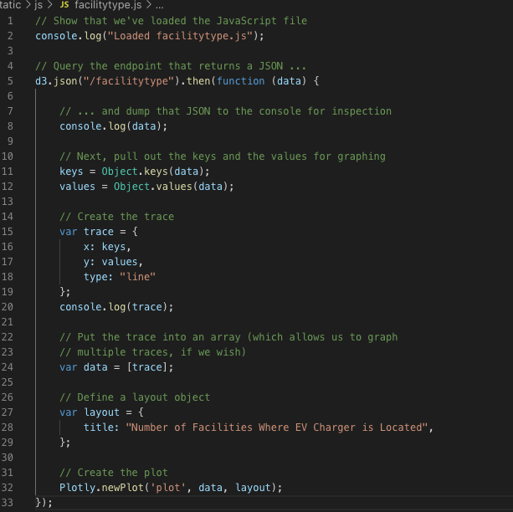
Facility type

Slide 11
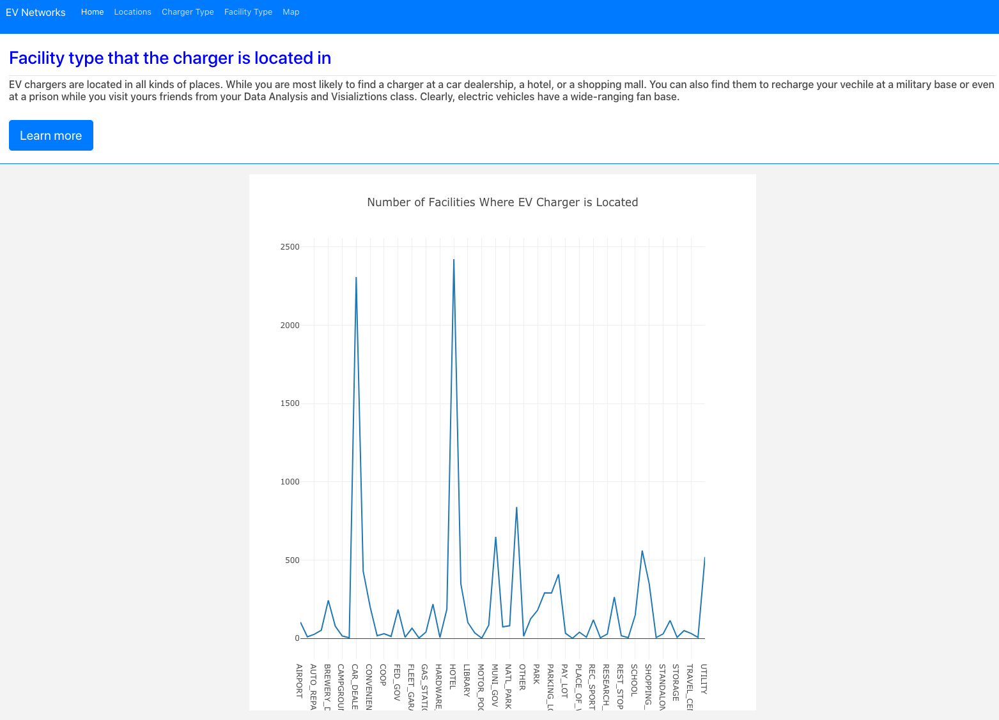
Facility type

Slide 12
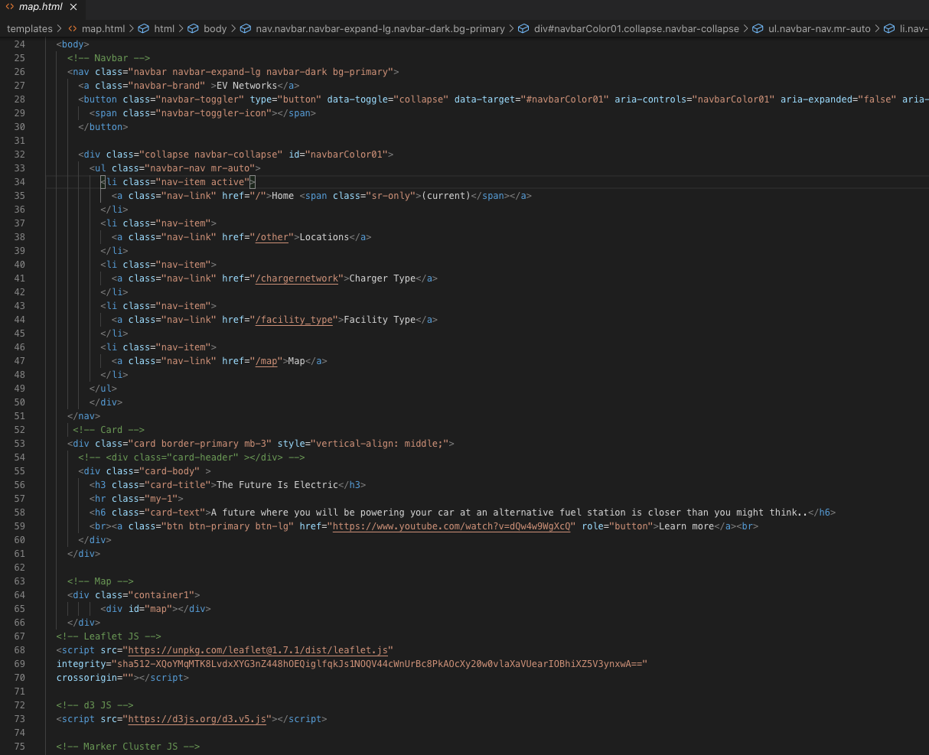
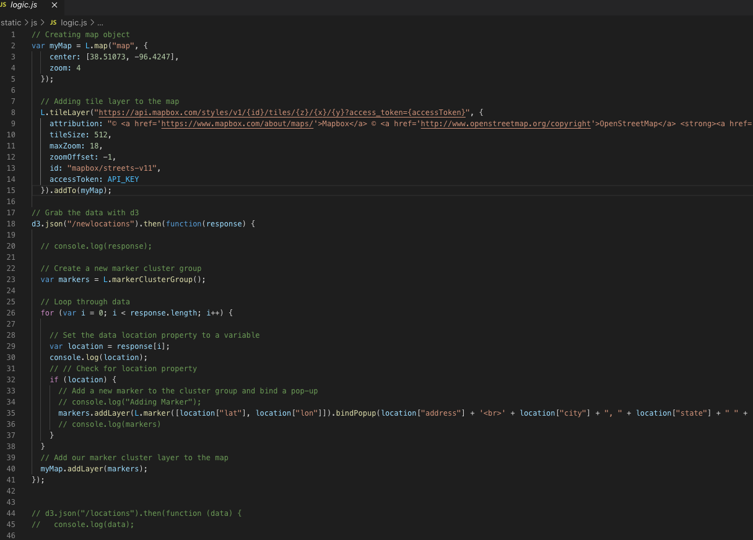
map

Slide 13
